Slide 1
QUEUING ANALYSIS

Slide 2
Overview
This is a summary of the Queuing Theory Notes on ODTU CLASS
READ THE QUEUING THEORY NOTES

Slide 3
System: Parameters, Metrics
λ
λ
λ
GIVEN➔Parameters: λ, μ
We want to find ➔ Metrics: E[Ns], E[Ts],E[NQ], E[TQ]
System: Queue+Server
Assumptions:
Infinite Buffer Space
λ< μ

Slide 4
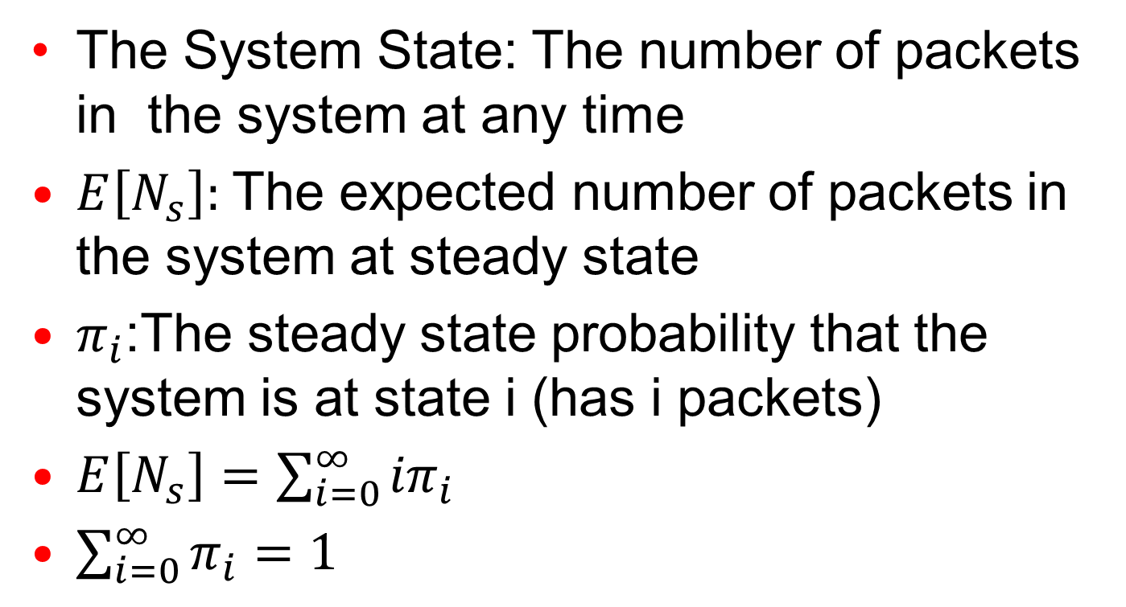
System State
The System State: The number of packets in the system at any time
$E\left[N_{s}\right]:$The expected number of packets in the system at steady state
$π_{i}$:The steady state probability that the system is at state i (has i packets)
$E\left[N_{s}\right]=\sum_{i=0}^{∞}{{iπ}_{i}}$
$\sum_{i=0}^{∞}{π_{i}}=1$

Slide 5
Change of System State
Arrival➔ change state from state i to i+1
Departure ➔change state from state i to i-1
Arrival
Arrival
Arrival
Arrival
0
1
i-1
i
i+1
Departure
Departure
Departure
Departure

Slide 6
Change of System State
Watch the system’s any state i long enough time T
N_{iup}:# of times state i goes up to i+1 ➔Average state transition rate from i to i+1=
N_{iup} /T= λ transitions per second
N_{idown}:# of times state i goes down to i-1=
➔Average state transition rate from i to i-1= N_{idown} /T= μ transitions per second

Slide 7
Change of System State
Define average time to change state from state i to i+1=1/λ sec/change
Define average time to change state from state i to i-1=1/μ sec/change

Slide 8
Queue Analysis with Markov Chain
IF: State transition times are exponentially distributed➔
Inter-arrival times are exponentially distributed with average of 1/λ
Service times are exponentially distributed with average of 1/μ ➔ Packet sizes are exponentially distributed
Markov Processes (memoryless)
λ
λ
λ
λ
0
1
i-1
i
i+1
μ
μ
μ
μ

Slide 9
Queue Analysis with Markov Chain
Balance at the steady state:
Total Rate of going into a state = Total rate of leaving the state
λ
λ
λ
λ
0
1
i-1
i
i+1
μ
μ
μ
μ

Slide 10
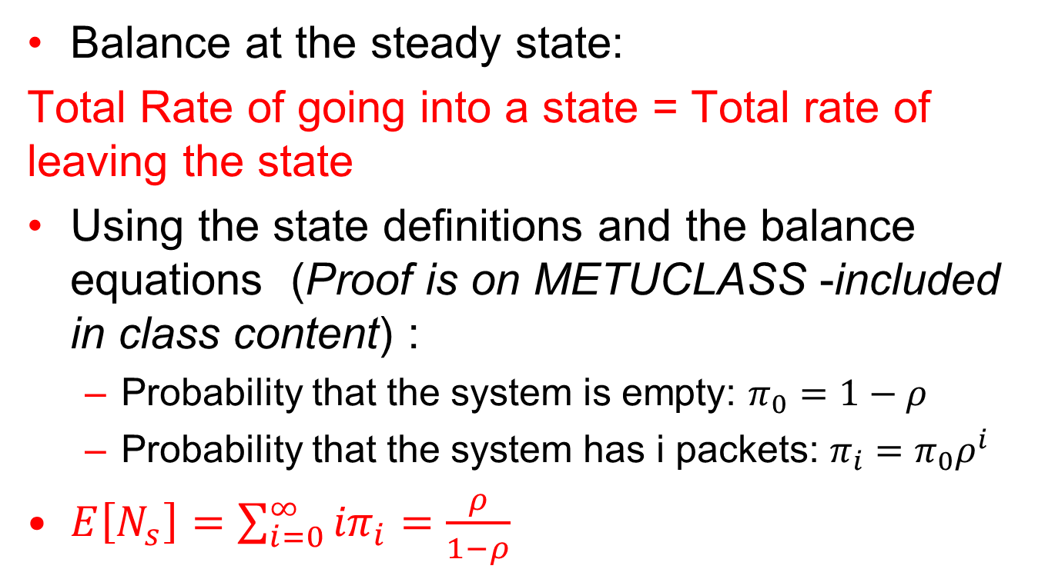
Queue Analysis with Markov Chain
Balance at the steady state:
Total Rate of going into a state = Total rate of leaving the state
Using the state definitions and the balance equations (Proof is on METUCLASS -included in class content) :
Probability that the system is empty: $π_{0}=1−ρ$
Probability that the system has i packets: $π_{i}=π_{0}ρ^{i}$
$E\left[N_{s}\right]=\sum_{i=0}^{∞}{{iπ}_{i}=\frac{ρ}{1−ρ}}$

Slide 11
Queue Analysis with Markov Chain
What kind of queue did we analyze with the Markov Chain model? (A/B/1 in Kendall’s notation)
Inter-arrival times are exponentially distributed with average of 1/λ
Service times are exponentially distributed with average of 1/μ ➔ Packet sizes are exponentially distributed
M/M/1 Queue:
A: Exponential arrivals
B: Exponential service times

Slide 12
Queue Analysis with Markov Chain
M/M/1 Queue:
E[Ns]= ρ/(1- ρ) (ONLY for M/M1)
➔ E[NQ]=E[Ns]- ρ= ρ²/(1-ρ)=
E[Ts]= E[Ns]/ λ=1/ μ- λ➔Little’s Law (for all queuing systems including M/M/1 where there are no packet losses)

Slide 13
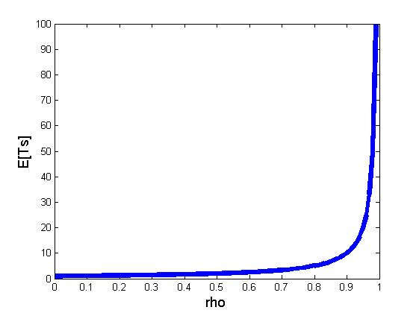
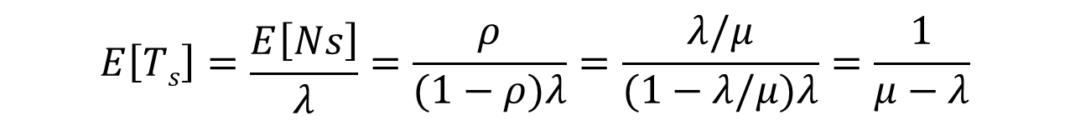
M/M/1 Queue: Response Time vs. Arrivals
For some λ, μ
$$E\left[Ts\right]=\frac{E\left[Ns\right]}{λ}=\frac{ρ}{(1−ρ)λ}=\frac{λ/μ}{(1−λ/μ)λ}=\frac{1}{μ−λ}$$

Slide 14
Exponential Distribution
We say that a random variable X is distributed exponentially with rate λ:
X~Exp(λ)
if X has the probability density function:
f(x)= λe- ^{λx}, x ≥0
0 otherwise

Slide 15
Exponential Distribution
E[X]=1/λ
Var[X]= 1/λ²
Note: λ referred to as the rate of the distribution because the mean of the distribution is 1/ λ

Slide 16
Exponential Distribution
Exponential distribution is memoryless:
Let X~Exp(λ)
P(X>s+t | X>t)=P(X>s)
The probability that you wait for at least another s seconds for the bus is the same as:
The probability that you just came to the bus stop and wait for s seconds before the bus comes.
Independent of t
Example:
Let X show the waiting time for a bus
You waited for the bus for t seconds

Slide 17

Poisson Process
Consider a stochastic counting process N(t)
N(t) represents the total number of events in [0, t]
N(0)=0
t > 0, N(t)>=0

Slide 18

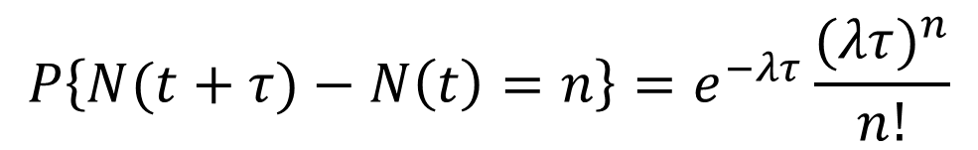
Poisson Process
A Poisson process with rate λ is a sequence of events
The number of events that occur in disjoint intervals are independent
The number of events in any [t, t + τ] is Poisson distributed with parameter λτ
$$P\left\{N(t+τ)−N\left(t\right)=n\right\}=e^{−λτ}\frac{{(λτ)}^{n}}{n!}$$
$$n=0, 1, 2,…$$
λ is the rate of the process as E[N(t)]= λt.

Slide 19
Poisson Process
Times between the events are random variables with the following properties:
Independently and identically distributed
(i.i.d: each random variable has the same probability distribution as the others and all are mutually independent.)
exponentially distributed with rate λ
exponentially distributed ↔ number of events over interval [t,t+x] is Poisson distributed

Slide 20
M/M/1 Queue Summary
M/M/1 Queue is a queue with Poisson arrivals (exponentially distributed interarrival times) and exponentially distributed packet sizes!
E[Ns]= ρ/(1- ρ)
E[NQ]=E[Ns]- ρ= ρ²/(1-ρ)
E[Ts]= E[Ns]/ λ=1/ (μ- λ)➔Little’s Law

Slide 21
Poisson Process Properties
If arrivals to single server with exponential service times are Poisson with mean λ, departures are also Poisson with mean λ, if (λ<μ)
Remember: Departures are always with mean λ if λ<μ1 (Throughput X=λ)
λ
λ
λ
μ1
μ2
λ<μ1
λ<μ2

Slide 22
Properties of Poisson Process
If two or more independent Poisson process A₁ , ..., A_{k} are merged into a single process A = A₁ + A₂ + ... + A_{k} , the process A is also Poisson with a rate equal to the sum of the rates of its components
λ₁
merge
A₁
λ_{i}
A_{i}
A
Poisson process
λ_{k}
A_{k}
independent Poisson processes

Slide 23
Properties of Poisson Process
If a Poisson process A is split into two other processes A₁ and A₂ by randomly assigning each arrival to A₁ or A₂ , processes A₁ and A₂ are Poisson
with probability p
split randomly
λ₁
A₁
A
Poisson process
with probability (1-p)
λ₂
A₂
Poisson processes

Slide 24
Examples

Slide 25
Example
An M/M/1 packet transmission system has an arrival rate λ packets/sec. Assume that the arrival rate is increased from λ to k λ , k>1. At the same time (keeping the packet length distribution unchanged), the transmission capacity is increased by a factor of k.
Result:
Only per packet delay is decreased. An arriving packet
sees the same (average) # of pkts in the queue but
they are moving k times faster.

Slide 26
Queuing System Application Multiplexing Traffic
A link may carry several traffic streams multiplexed
Assume that
m statistically identical and independent Poisson packet streams with an arrival rate of λ/m are transmitted over a communication line
The packet lengths for all streams are independent and exponentially distributed, and the average transmission time is 1/μ
Channel Allocation Mechanism affects the average packet delay
Statistical Multiplexing
Static Allocation

Slide 27
Queuing System Application Multiplexing Traffic
Statistical multiplexing
Packet streams are merged into a single Poisson stream with rate λ and transmitted on FCFS basis
Static allocation (Time- and Frequency-division multiplexing, TDM/FDM)
The transmission capacity is divided into m equal portions, each of which is an M/M/1 queue
Which one do you think gives faster (on average) service?

Slide 28
Queuing System Application Multiplexing Traffic
Statistical multiplexing
Packet streams are merged into a single Poisson stream with rate λ and transmitted on FCFS basis
λ/m
λ/m
λ
λ/m

Slide 29
Queuing System Application Multiplexing Traffic
Static allocation (Time- and Frequency-division multiplexing, TDM/FDM)
The transmission capacity is divided into m equal portions, each of which is M/M/1 queue
λ/m
λ/m
λ/m

Slide 30
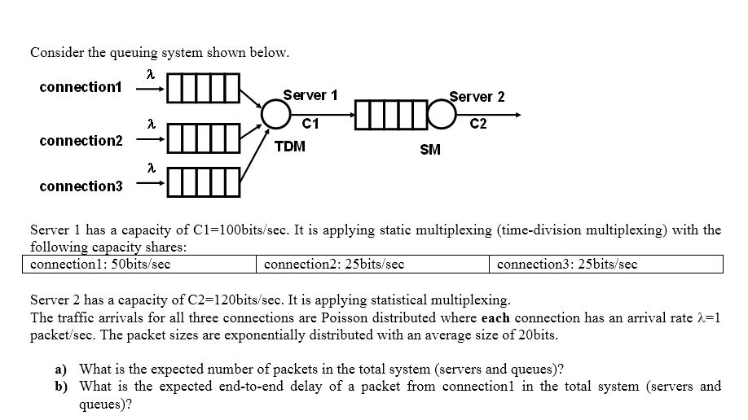
Queuing System Application Example 1

Slide 31
Queuing System Application Example 1 Solution
Server 1: TDM: Server is used by 3 connections
Assumption: TDM preserves Poisson merging
Each Connection sees a separate M/M/1 queue system
µ₁=2.5p/s ➔ρ₁= 1/2.5=0.4
µ₂=µ₃=1.25p/s ➔ρ₂=ρ₃=1/1.25=0.8
Server behaves like a server with ρ₁ (0.4) 50% of the time, a server with ρ₂ (0.8) 25% of the time, a server with ρ₃ (0.8) 25% of the time
E[Nserver]=0.4*0.5+0.8*0.25+0.8*0.25=0.6

Slide 32
Queuing System Application Example 1 Solution
Server 1: TDM: Server is used by 3 connections: All queues are isolated:
E[NQ₁]= ρ₁²/(1-ρ₁)=0.16/0.6
E[NQ₂]= ρ₂²/(1-ρ₂)=0.64/0.2
E[NQ₃]= ρ₃²/(1-ρ₃)=0.64/0.2
E[Ns]=E[NQ₁]+E[NQ₂]+E[NQ₃]+E[Nserver]
=0.16/0.6+0.64/0.2+0.64/0.2+0.6=43.6/6

Slide 33
Queuing System Application Example 1 Solution
Server 2: SM, all connections see the same server, share the same queue
µ_{server2}=120/20=6p/s
λ_{Total}=3p/s
ρ=0.5➔ E[Ns]= ρ/(1- ρ)=1
TOTAL=43.6/6+1

Slide 34
Queuing System Application Example 1 Solution
E[TS] for connection 1=E[TS_{TDM}]+E[TS_{SM}]
=1/(µ₁-λ₁)+1/(µ_{server2}-λ_{Total})
=1/(2.5-1)+1/(6-3)=1sec

Slide 35
Example 2
Repeat the analysis in class for M/M/1/N (Finite buffer with N buffers)
Write the balance equations: rate in rate out
Find the limiting probabilities: π_{i}
Find π₀ using Σπ_{i}=1 (FINITE SUM)
Probability of a packet loss: Probability of a packet arriving and finding the system with N packets: π_{N}
λ
λ
λ
0
1
2
N-1
N
μ
μ
μ

Slide 36
More Exercises

Slide 37
Queuing System Exercise Example 3
A 50 kbps line is used to support 10 sessions each generating poisson traffic at a rate of 150 packets/min. Packet lengths are exponentially distributed with mean 1000 bits. For each session:
a) find the average # of packets in the queue and the average delay per packet when i) TDM and ii) SM is used
a-i) TDM: All sessions behave like separate queuing system For each session: λ=150/60=2.5 pkts/sec
Server capacity per queue=50 kbps/10=5kbps
μ=5000bits/sec=5 pkts/sec
utilization ρ =2.5/5=0.5
E[NQ]=ρ²/(1-ρ)=0.5 per queue➔10x0.5=5 for all queues
E[Ts]=1/(μ-λ)=0.4 seconds per packet

Slide 38
Queuing System Exercise Example 3
A 50 kbps line is used to support 10 sessions each generating poisson traffic at a rate of 150 packets/min. Packet lengths are exponentially distributed with mean 1000 bits. For each session:
a) find the average # of packets in the queue and the average delay per packet when i) TDM and ii) SM is used
a-ii) SM: Single queue
For each session: λ=150/60=2.5 pkts/sec
arrival rate=Σλ=10λ=10x2.5 pkts/sec=25 pkts/sec
line capacity=50 kbps=50000bits/sec
μ=50 pkts/sec
utilization ρ=25/50=0.5
E[NQ]=ρ²/(1-ρ)=0.5 for the single queue
E[Ts]=1/(μ-λ)=0.04 seconds per packet

Slide 39
Queuing System Exercise Example 3
A 50 kbps line is used to support 10 sessions each generating poisson traffic at a rate of 150 packets/min. Packet lengths are exponentially distributed with mean 1000 bits. For each session:
b) if 5 of the session generate traffic with rate of 250 pkts/min and other 5 with 50 pkts/min, find the average # of packets in the queue and the average delay per packet when i) TDM and ii) SM is used
b-i) TDM:
For each session with 250 pkts/min: λ=250/60 pkts/sec
line capacity per queue =50 kbps/10=5kbps=5000bits/sec, μ=5pkts/sec
utilization ρ=250/60*1/5=0.833
E[NQ]=ρ²/(1-ρ)=4,158 per queue
For each session with 50 pkts/min: λ=50/60 pkts/sec
ρ=50/60*1/5=0.166 ➔ E[NQ]=0.033 per queue
5(4.158+0.033)=20.95 ➔ for all queues

Slide 40
M/M/1 Queuing System: Exercise
Customers arrive at a fast-food restaurant as a Poisson process with an arrival rate of 5 per min
Customers wait at a cash register to receive their order for an average of 5 minutes
Service times to customers are independent and exponentially distributed
What is the average service rate at the cash register? (Answer: 5.2)
If the cash register serves 10% faster, what is the average waiting time of customers? (Answer: 1.39min)

Slide 41
SUMMARY

Slide 42
Summary
System parameters:
Average arrival rate: λ (packets/second)
λ=1/average interarrival time
depends on traffic pattern
Average service rate: μ (packets/second)
μ=1/expected service time=1/E[S]
E[S]=average packet size/line rate
depends on packet size distribution
Number of servers
We always assume FCFS
μ
λ
Queue
Server
System
λ<μ

Slide 43
Summary
Performance metrics
E[Ns], E[NQ], E[Ts], E[TQ]
Utilization (U or ρ)=fraction of busy time
By definition:
Probability that the server is busy=Utilization
Probability that the system is idle=1-Utilization
If there are no packet losses➔ ρ=λ/μ
Packet losses can happen:
If λ≥μ finite or infinite buffer space
Finite buffer space

Slide 44
Summary
Utilization example: 4 packets served on the outgoing line with C bps capacity. Assume 4 is a large enough number to have averages.
IA₁
IA₂
IA₃
IA₄
S₁
S₂
S₃
S₄
P1
P2
P3
P4
Observation time: T

Slide 45

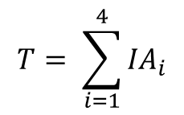
Summary
P_{i}: Size of packet i in bits.
S_{i}: Service time for packet i. S= P_{i}/C
IA_{i}: Interarrival time for packet I
X=λ➔Output line can be used to show the arrivals
$$T= \sum_{i=1}^{4}{{IA}_{i}}$$
$ρ=\frac{\sum_{i=1}^{4}{S_{i}}}{T}=\frac{\sum_{i=1}^{4}{S_{i}}}{\sum_{i=1}^{4}{{IA}_{i}}}$=$\frac{\left[\sum_{i=1}^{4}{S_{i}}\right]/4}{\left[\sum_{i=1}^{4}{{IA}_{i}}\right]/4}=\frac{E[S]}{E[IA]}=\frac{λ}{μ}$
IA₁
IA₂
IA₃
IA₄
S₁
S₂
S₃
S₄
P1
P2
P3
P4
Output line during observation time: T

Slide 46
Summary
Note that during T, λ<μ all the time
What do you say for the queue size during T?
Draw a scenario where λ>μ during some part of T but on the average λ<μ
IA₁
IA₂
IA₃
IA₄
S₁
S₂
S₃
S₄
P1
P2
P3
P4
Observation time: T

Slide 47
Summary
Performance metrics
Throughput (X)=Rate of completion of packets
Note that X≠ μ➔being able to serve at a certain rate does not mean that there are packets to serve
X=U. μ ➔Given that there are packets the server can serve at rate μ

Slide 48
Summary
Little’s Law:
Only assumption: what goes in goes out
E[Ns]=E[Ts]. λ
Valid for:
Any number of servers, any service order (doesn’t have to be FCFS), any arrival and service statistics
What goes in goes out no losses
λ
λ
λ

Slide 49
Summary
Little’s Law
λ
λ
λ
E[Ns]= λE[Ts]
λ
λ
λ
E[NQ]= λE[TQ]
E[NServer]= λE[TinServer]
ρ=λE[S]=λ/μ
λ
λ
λ

Slide 50
Summary
For infinite and stable queues:
What goes in goes out
Throughput➔ X=λ
Define: ρ=λ/μ
Utilization➔ U=ρ=λ/μ

Slide 51
Summary
M/M/1 queues:
Interarrival times are exponentially distributed
Service times are exponentially distributed➔ at fixed line rate, packet sizes are exponentially distributed
Performance:
Markov Chain Model:
Prob that the system is idle:π₀=1-ρ
Prob that there are i packets in the system π_{I} =(1-ρ) ρ^{i}
E[Ns]= ρ/1- ρ ➔ E[NQ]=E[Ns]- ρ
E[Ts]= E[Ns]/ λ=1/ μ- λ➔Little’s Law
E[TQ]=E[Ts]-E[S]

Slide 52
QUEUING ANALYSIS

